Slide 1

SpeakEasy
Helping Every Voice Be Heard

Slide 2

Aphasia a silent struggle

Slide 3



Aphasia means having trouble with language
after a brain injury
Aphasia can make people feel sad, lonely, and
isolated
Having Aphasia is like going back to zero.
Elementary things are now a daunting chore.

Slide 4
Problem Statement
People with aphasia struggle to communicate because they have difficulty recalling and comprehending words, which leads to social isolation and frustration.

Slide 5

Communicate their needs effectively with caregivers
Comprehend and follow what others are saying

Slide 6
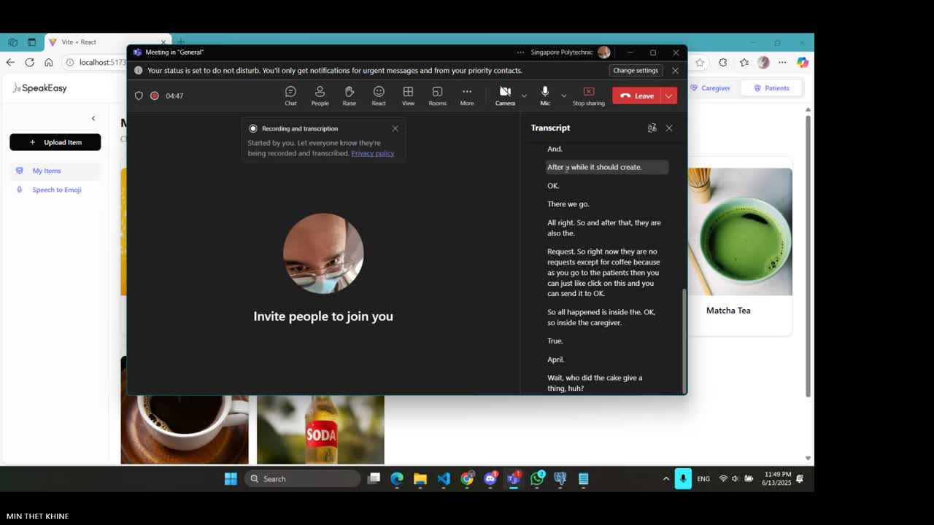
Demo

Slide 7


Roadmap
Q3 2025
Prototyping
Ai Model Tuning
Q4 2025
Early User Onboarding
Continuous Refinement
Q1 2026
Deploy and Publish

Slide 8
ai tools and ideas
AI tool
AI tool
AI tool
AI tool
Write your ideas to use this tool in EFL.
Write your ideas to use this tool in EFL.
Write your ideas to use this tool in EFL.
Write your ideas to use this tool in EFL.
AI tool
AI tool
AI tool
AI tool
Write your ideas to use this tool in EFL.
Write your ideas to use this tool in EFL.
Write your ideas to use this tool in EFL.
Write your ideas to use this tool in EFL.

Slide 9




Tech stack
Vite + React
Node JS
Python
Vite to host the front-end React for styling and webpage building
Express server to host and manage APIs and Logic
NLTK + spaCy
for NLP

Slide 10
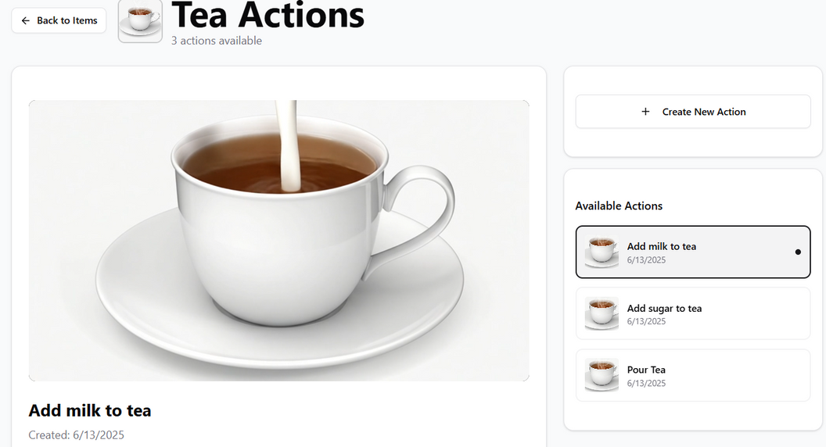
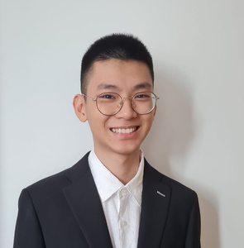






Slide 11

References
https://www.youtube.com/watch?v=fIMRrcHJNYg
https://pubs.asha.org/doi/10.1044/2025_PERSP-24-00141

Slide 12
Demo

